Slide 1
IO Operations
18ESC108A Elements of Computer Science and Engineering
B. Tech. 2018
Ami Rai E.
Roopa G
Chaitra S
Department of Computer Science and Engineering
Faculty of Engineering and Technology
Ramaiah University of Applied Sciences

Slide 2
Objectives
At the end of this lecture, student will be able to
Explain library functions and format used to perform input/output operations
Use strings for the terminal input and output of text
Construct a simple Python program that performs inputs, calculations, and outputs

Slide 3
Topics
Input operations
Output operations
Output formatting

Slide 4
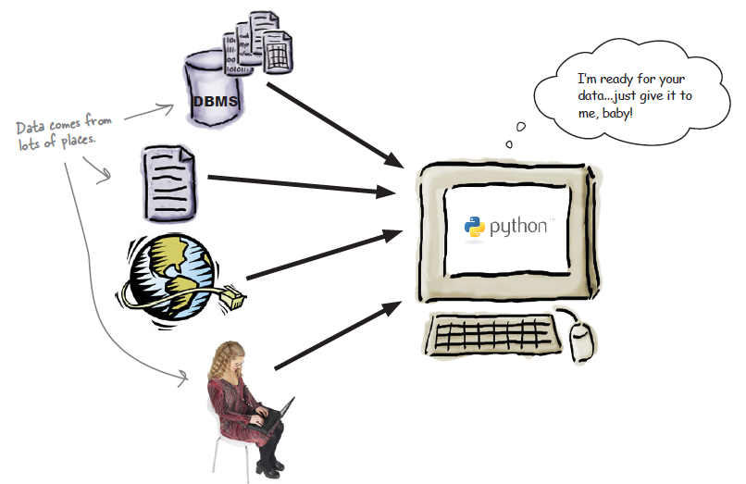
Data to The Computer
Most of the programs conform to the input-process-output model: data comes in, gets manipulated, and then is stored, displayed, printed, or transferred

Slide 5
Input From The User
Python has the input() built in function to display a prompt on screen, and then accept keyboard input, returning what was entered as a string to the code
>>> res = input('What is your favorite programming language: ')
What is your favorite programming language: Python
>>> res
Python
res = input('What is your favorite programming language: ')
print(res)
What is your favorite programming language: Python
Python

Slide 6
Reading a Numeric Value
When reading a numeric value from the user
programmer must use the input() function to get the string of characters
use the int or float syntax to construct the numeric value that character string represents
>>>year = int(input(“What is your age?” ))

Slide 7
Splitting The Input
If the user enters multiple pieces of information on the same line, it is common to call the split method on the result
reply = input(" Enter x and y, separated by spaces:" )
pieces = reply.split( ) # returns a list of strings, as separated by spaces
x = int(pieces[0])
y = int(pieces[1])
print(x,y)
The output is
Enter x and y, separated by spaces:10 20
10 20

Slide 8
Splitting The Input contd.
result = input(" Enter two numbers, separated by spaces:" )
x,y = result.split()
print(y)
Enter x and y, separated by spaces:10 20
20
>>> a,b='h i'.split(' ')
>>> a
'h'
>>> b
'i'

Slide 9
Display on the Screen
The built-in function, print, is used to generate standard output to the console
In its simplest form, it prints an arbitrary sequence of arguments, separated by spaces, and followed by a trailing newline character
print(“hello”) #outputs the string “hello”
Arguments need not be string instances
print(1.5 * 3)
4.5
Without any arguments, the command print( ) outputs a single newline character

Slide 10
Printing Multiple Items
To print multiple items, pass all the items in sequence separated by commas
They are automatically separated by commas
print(“hello”,”world”)
hello world
print(“2+3=”,2+3)
2+3= 5 # there is a space after the = operator

Slide 11
Printing Multiple Items contd.
a=20
b=10
c=25
print(c,"is greater than",a,"and",b)
25 is greater than 20 and 10

Slide 12
Separating Items
To print multiple items but do not want space to be the separator, pass the separator string as an argument to print()
print("hello","world",sep=',')
hello,world
print("hello","world",sep='<->')
hello<->world
print("welcome","to","python",sep='-')
welcome-to-python
print("2+3=",2+3,sep="")
2+3=5 # there is no space after the = operator

Slide 13
Terminating Items
By default, print() function prints a newline character ( \n ) after printing all the items
To control the termination of items, use the keyword end
print("Is Python a dynamic language?",end="\nPython")
Is Python a dynamic language?
Python
print("Is Python a dynamic language?\n",end="Python")
Is Python a dynamic language?
Python
print("Is Python a dynamic language?\t",end="Python")
Is Python a dynamic language? Python

Slide 14
Quotation Marks
Strings in Python are enclosed in quotation marks
Python does not differentiate between single quotes and double quotes
Single quotes
Any single quote character inside the string needs to be escaped by prefixing it with backslash
Example
print('Hello, World!')
print(‘ ”Hi” from \’India\’ ')
The output is
Hello, World!
“Hi” from ‘India’

Slide 15
Quotation Marks contd.
Double quotes
Any double quote character inside the string needs to be escaped by prefixing it with backslash
Example
print(“Hello, World!”)
print(“ ‘Hi’ from \”India\” “)
The output is
Hello, World!
‘Hi’ from “India”

Slide 16
Formatting Strings Using format()
The format() function searches the string for placeholders
These placeholders are indicated by braces ( { } ) and indicate that some value needs to be substituted there
The format() takes any number of parameters
It is divided into two types of parameters:
Positional parameters - list of parameters that can be accessed with index of parameter inside curly braces {index}
Keyword parameters - list of parameters of type key=value, that can be accessed with key of parameter inside curly braces {key}

Slide 17
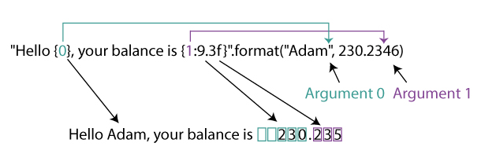
Positional Arguments
Argument 0 is a string "Adam" and Argument 1 is a floating number 230.2346

Slide 18
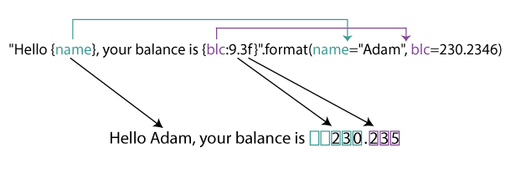
Keyword Arguments
Instead of just the parameters, a key-value for the parameters is used; name="Adam" and blc=230.2346

Slide 19
Formatting Strings - Examples
# default arguments
print("Hello {}, your balance is {}.".format("Adam", 230.2346))
# positional arguments
print("Hello {0}, your balance is {1}.".format("Adam", 230.2346))
#keyword arguments
print("Hello {name}, your balance is {blc}.".format(name="Adam", blc=230.2346))
# mixed arguments
print("Hello {0}, your balance is {blc}.".format("Adam", blc=230.2346))
All the above statements displays the same output
Hello Adam, your balance is 230.2346.

Slide 20
IO Operations - Example
# inputs two integers and displays their sum
>>> first = int(input( "Enter the first number: “ ))
Enter the first number: 23
>>> second = int(input( "Enter the second number: “ ))
Enter the second number: 44
>>> print( "The sum is“ , first + second)
The sum is 67

Slide 21
Summary
The print() function prints a list of items
The input() function prints an optional prompt message and reads in a single line of input
Output formatting can be done using format() method of String class

